Slide 1

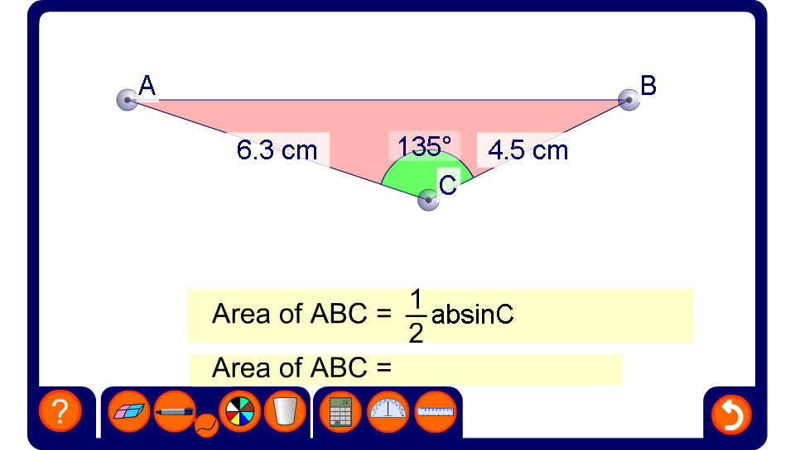


The area of a triangle using ½ ab sin C
Notes:
Drag the vertices of the triangle to produce a variety of examples. The solution can be hidden of revealed.
To vary the activity hide the angle or one of the sides by clicking on it. Reveal the area and ask pupils to find the missing angle or side length.
Be aware that the lengths of the sides and the angles have been rounded. This means that, for example, the three angles in the triangle may not add up to 180°.

